Slide 1
BRITISH AIRWAYS
PREDICTING CUSTOMER BUYING BEHAVIOUR

Slide 2
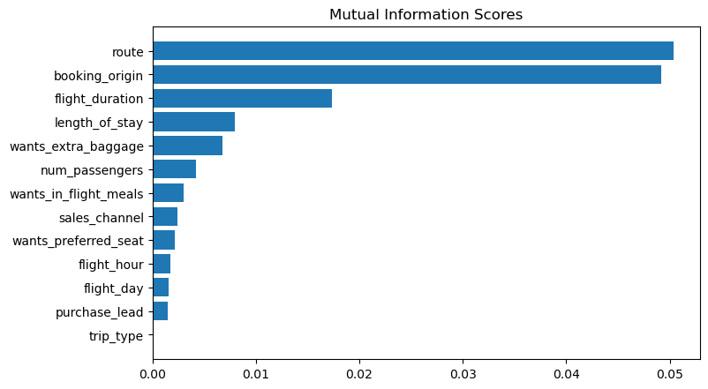
PREDICTING MODEL TO UNDERSTAND FACTORS THAT INFLUENCE BUYING BEHAVIOUR
We have Trained the data set with random forest Classifer model and received :
ACCURACY : 84.88
AUC SCORE : 0.558
route
booking_origin
flight_duration
wants_extra_baggage
length_of_stay
Are the top 5 features which influence Customer buying behviour.

